Slide 1
Choosing Coffee Shop Location

Slide 2
Real estate is expensive
Client wants to open a series of coffee shops in the GTA
Toronto real estate is expensive
They don’t want to take a gamble on a location and not get a positive ROI

Slide 3
What we can do
We can assess various locations for suitability using data already out there
Existing venues provide information
Competition
Opportunity

Slide 4
Analytic Plan
Use
Use k-means clustering to cluster GTA forward sortation areas
Base
Base clustering on venue types
Provide
Provide additional economic data for each area

Slide 5
Data Requirements
Neighbourhood FSA data
Co-ordinate data for FSA
Economic data for FSA
Venue type data

Slide 6
Data Sources
Neighbourhood FSA data
Wikipedia
https://en.wikipedia.org/wiki/List_of_postal_codes_of_Canada:_M
Co-ordinate data for FSA
Statistics Canada’s
Economic data for FSA
Canada Revenue Agency
https://www.canada.ca/en/revenue-agency/programs/about-canada-revenue-agency-cra/income-statistics-gst-hst-statistics/individual-tax-statistics-fsa/individual-tax-statistics-fsa-2017-edition-2015-tax-year.html
Venue type data
Four Square API

Slide 7
Data Cleaning
Data checked for missing or irrelevant data points
4 rows (out of 94 rows) dropped due to missing data

Slide 8
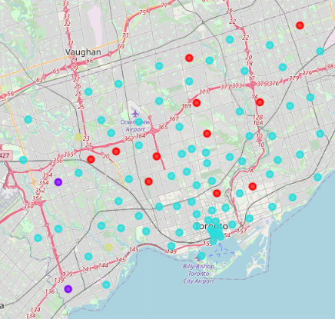
4 Identified Clusters

Slide 9
Most promising cluster
The cluster represented in red appeared the most promising
High number of recreational venues
Low number of existing food and drink services
No coffee shops/cafes in the top 10 venues
Diverse geography
Diverse income range

Slide 10
Red Sector Data
Borough | Total Population | Total Income per Cap | Net Income per Cap | Taxable Income per Cap | Cluster Labels | 1st Most Common Venue | 2nd Most Common Venue | 3rd Most Common Venue | 4th Most Common Venue | 5th Most Common Venue | 6th Most Common Venue | 7th Most Common Venue | 8th Most Common Venue | 9th Most Common Venue | 10th Most Common Venue
North York | 26010 | 44054.98 | 40817.49 | 39324.14 | 3 | Park | Food & Drink Shop | Yoga Studio | Dance Studio | Eastern European Restaurant | Drugstore | Donut Shop | Dog Run | Distribution Center | Discount Store
North York | 22570 | 54777.94 | 50934.51 | 49339.3 | 3 | Park | Japanese Restaurant | Pub | Metro Station | Yoga Studio | Dance Studio | Donut Shop | Dog Run | Distribution Center | Discount Store
York | 30200 | 34659.74 | 32632.25 | 30979.5 | 3 | Park | Women's Store | Pool | Yoga Studio | Curling Ice | Drugstore | Donut Shop | Dog Run | Distribution Center | Discount Store
East York | 26970 | 50671.97 | 46201.45 | 44701.63 | 3 | Park | Convenience Store | Metro Station | Yoga Studio | Dance Studio | Drugstore | Donut Shop | Dog Run | Distribution Center | Discount Store
North York | 16150 | 34011.76 | 31900.06 | 30049.97 | 3 | Park | Construction & Landscaping | Bakery | Yoga Studio | Deli / Bodega | Eastern European Restaurant | Drugstore | Donut Shop | Dog Run | Distribution Center
North York | 28490 | 40288.1 | 37400.14 | 35991.65 | 3 | Park | Yoga Studio | Dance Studio | Eastern European Restaurant | Drugstore | Donut Shop | Dog Run | Distribution Center | Discount Store | Diner
Central Toronto | 12020 | 211828.8 | 199085.5 | 192124.7 | 3 | Park | Swim School | Bus Line | Yoga Studio | Dance Studio | Drugstore | Donut Shop | Dog Run | Distribution Center | Discount Store
York | 19260 | 33422.27 | 31354.36 | 29138.42 | 3 | Park | Convenience Store | Yoga Studio | Dance Studio | Eastern European Restaurant | Drugstore | Donut Shop | Dog Run | Distribution Center | Discount Store
North York | 6520 | 133867.6 | 125571.9 | 122879.3 | 3 | Park | Convenience Store | Yoga Studio | Dance Studio | Eastern European Restaurant | Drugstore | Donut Shop | Dog Run | Distribution Center | Discount Store
Scarborough | 46190 | 28185.36 | 26218.77 | 24482.46 | 3 | Playground | Park | Yoga Studio | Curling Ice | Drugstore | Donut Shop | Dog Run | Distribution Center | Discount Store | Diner
Downtown Toronto | 11600 | 202622.1 | 190372.7 | 184430.5 | 3 | Park | Playground | Trail | Yoga Studio | Curling Ice | Drugstore | Donut Shop | Dog Run | Distribution Center | Discount Store

Slide 11
Conclusion
Identified a cluster of 11 regions in the GTA suitable for the opening of a coffee shop
This region is spread geographically and has a range of income levels within it
There is low competition with high foot traffic potential

Slide 12
Future Directions
Identify real estate targets
Assess price using income data for the region
Once targets are identified more detailed data will need to be gathered
E.g. physical location assessment, market value assessment

